Slide 1
Introduction.
Brief history
Photochemical reactions have been known for almost as long as chemistry
Most observations remained uninterpreted until the 19th century
Important work done in Italy by Ciamician, Silber and Paterno
After World War I, it became the province of the physical chemistry for 35 years
In the 50’s: general interest in photochemistry by the organic chemist due in part by
natural product synthesis
In the 60’s: emergence of mechanistic organic photochemistry and merging of the organic
and physical viewpoints.
Arnold, D.R.; Baird, N.C.; Bolton, J.R.; Brand, J.C.D.; Jacobs, P.W.M.; de Mayo, P.; Ware, W.R. Photochemistry An Introduction, Academic Press Inc., New York, 1974

Slide 2
Brief introduction
Photochemistry
The branch of chemistry which deals with the study of chemical reaction initiated by light.
Energy of photon
The photon is quantized energy: light quantum
Where h is the Plank constant, C the velocity of light in vacuum, λ the wave-length of the light, and ν the wave number.

Slide 3
3×10⁵ m 3.98×10⁻⁸ kJ mol⁻¹
radio
3×10⁻¹ m 3.98×10⁻⁴ kJ mol⁻¹
micro-wave
6×10⁻⁴ m 1.99×10⁻¹ kJ mol⁻¹
Microwave chemistry
far-infrared
3×10⁻⁵ m 3.99 kJ mol⁻¹
near-infrared
800 nm 149.5 kJ mol⁻¹
visible
photochemistry
400 nm 299.0 kJ mol⁻¹
ultra-violet
150 nm 797.9 kJ mol⁻¹
vacuum violet
50 nm 239×10⁴ kJ mol⁻¹
radiochemistry
X-ray
5 nm 1.20×10⁹ kJ mol⁻¹

Slide 4
Electromagnetic spectrum relevant for photochemistry
IR
~700 nm
~ 1.77 eV
~ 170 kJ/mol
~ 14300 cm^{–1}
wavelength
energy / frequency
~400 nm
~ 3.1 eV
~ 300 kJ/mol
~ 25000 cm^{–1}
UV
~200 nm
~ 6.2 eV
~ 600 kJ/mol
~ 50000 cm^{–1}
VUV

Slide 5
Electromagnetic spectrum
v i s i b l e
microwave
infrared
ultraviolet
X-ray
γ radiation
10⁸
10⁶
10⁴
100
10
0.01
wavelength, nm
10⁸
10¹⁰
10¹²
10¹⁴
10¹⁶
10¹⁸
10²⁰
frequency, s^{–1}
10^{– 4}
10 ^{– 2}
1
10
100
10³
10⁴
10⁶
10⁸
energy, kJ/mol

Slide 6
Interaction between light and media
absorption
transmission
Reflection
Scattering
refraction
Lambert’s law:
when a beam of monochromatic radiation passes through a homogeneous absorbing medium, equal fraction of the incident radiation are absorbed by successive layer of equal thickness of the light absorbing substance
dx
I- intensity of light, x the thickness of the medium, a the absorption coefficient.

Slide 7
Beer’s law:
The equal fractions of the incident radiation are absorbed by equal changes in concentration of the absorbing substance in a path of constant length.
ε Is the molar extinction coefficient, C the molar concentration.
Both Lambert’s law and its modification are strictly obeyed only for monochromatic light, since the absorption coefficients are strong function of the wave-length of the incident light.

Slide 8
Introduction.
Basic laws
Activation of reaction is provided by the absorption of a photon
E = hν
ν = c / λ
Energy conversion table
λ / nm | kJ•mol⁻¹
200 | 598
250 | 479
300 | 399
350 | 342
400 | 299
500 | 239
600 | 200
700 | 171
E = hc / λ
E = Nhν = Nhc / λ
E = 1,197×10⁵ kJ•mol⁻¹/ λ
h: Planck’s constant = 6.627×10³⁴ J•s
ν: frequency (s⁻¹)
c: speed of light = 2,998 ×10⁸ m•s⁻¹
N: Avagadro’s number = 6,023 ×10²³ mol⁻¹
Arnold, D.R.; Baird, N.C.; Bolton, J.R.; Brand, J.C.D.; Jacobs, P.W.M.; de Mayo, P.; Ware, W.R. Photochemistry An Introduction, Academic Press Inc., New York, 1974

Slide 9
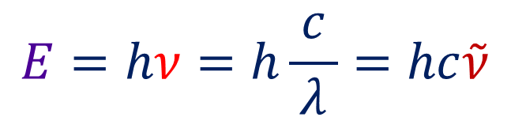
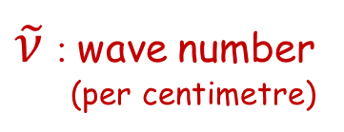
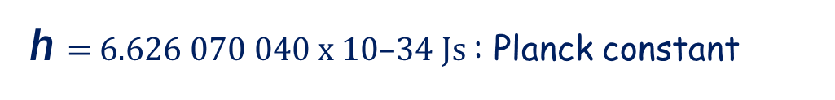
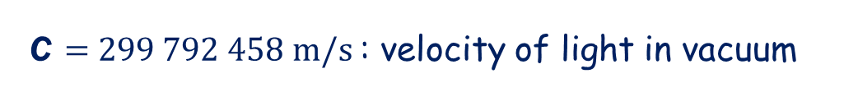
Unit conversions in photochemistry
E : energy
λ : wavelength
ν : frequency (per second)
from → to | eV | cm^{–1} | kcal/mol | kJ/mol | Hz (s^{–1})
eV | 1 | 8 065.73 | 23.060 9 | 96.485 3 | 2.418 04x10¹⁴
cm^{–1} | 1.239 81x10^{–4} | 1 | 0.002 859 11 | 0.011 962 7 | 2.997 93x10¹⁰
kcal/mol | 0.043 363 4 | 349.757 | 1 | 4.18400 | 1.048 54x10¹³
kJ/mol | 0.010 364 10 | 83.593 | 0.239001 | 1 | 2.506 07x10¹²
Hz (s^{–1}) | 4.135 58x10^{–15} | 3.335 65x10^{–11} | 9.537 02x10^{–14} | 3.99031x10^{–13} | 1

Slide 10
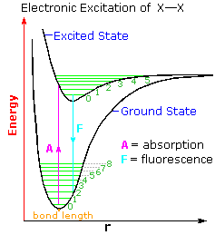
Photoexcitation:
Upon photoactivation, the molecules or atoms can be excited to a higher electronic, vibrational, or rotational states.
A + hγ → A*
The lifetime of the excited atom is of the order of 10⁻⁸ s. Once excited, it decays at once.

Slide 11
Orbitals That You Should Know
Orbital types
n orbitals:
π and π* orbitals:
σ and σ* orbitals:
Non-bonding
Overlap of p orbitals
Overlap of sp³ orbitals
Arnold, D.R.; Baird, N.C.; Bolton, J.R.; Brand, J.C.D.; Jacobs, P.W.M.; de Mayo, P.; Ware, W.R. Photochemistry An Introduction, Academic Press Inc., New York, 1974

